Slide 1
Predictive Maintenance of Industrial Machinery
CAPSTONE PROJECT
Presented By:
1. Kancharla Badri Narayana- Vasavi College of Engineering - IT

Slide 2
OUTLINE
Problem Statement (Should not include solution)
Proposed System/Solution
System Development Approach (Technology Used)
Algorithm & Deployment
Result (Output Image)
Conclusion
Future Scope
References

Slide 3
Problem Statement
Predictive Maintenance of Industrial Machinery
Develop a predictive maintenance model for a fleet of industrial machines to anticipate failures before they occur. This project will involve analyzing sensor data from machinery to identify patterns that precede a failure. The goal is to create a classification model that can predict the type of failure (e.g., tool wear, heat dissipation, power failure) based on real-time operational data. This will enable proactive maintenance, reducing downtime and operational costs.

Slide 4
Proposed Solution
Data Collection:
Utilising sensor data from the Kaggle dataset (e.g., air/process temperature, rotational speed, torque, tool wear).
Incorporating real-time operational data to enhance prediction accuracy.
Data Preprocessing:
AutoAI cleans data, handles missing values, encodes categorical variables (e.g., machine type), and scales numerical features.
Feature engineering extracts predictive patterns from sensor data.
Machine Learning Algorithm:
AutoAI tests multiple algorithms (e.g., Random Forest, XGBoost) for multiclass classification.
Optimized using metrics like F1 Score, with performance validated by ROC and Precision-Recall curves, showing high sensitivity and precision across failure types.
Deployment:
Deploy the model as a REST API endpoint on IBM Watson Machine Learning for real-time predictions.
Enable integration into industrial maintenance systems.
Evaluation:
Assess model performance using ROC curve (AUC close to 1), Precision-Recall curve (high precision at various recall levels), and Precision-Threshold curve (stable precision above 0.7).
Fine-tune based on continuous monitoring and feedback.
Result:
Model achieves robust prediction accuracy, with visualizations (e.g., ROC, Precision-Recall) indicating effective failure type classification.

Slide 5
System Approach
Requirements: IBM Cloud Lite, Kaggle dataset, Object Storage
Tools: AutoAI, Watson Machine Learning, Python libraries
Methodology: Data prep, model selection, training, deployment

Slide 6
Algorithm & Deployment
Algorithm Selection
Chosen: Snap Random Forest Classifier (via AutoAI).
Overview: Ensemble of decision trees for multiclass classification.
Justification: Handles imbalanced failure types (e.g., tool wear, power failure) and complex sensor data patterns effectively.
Data Input:
Features: Type, Air temperature [K], Process temperature [K], Rotational speed [rpm], Torque [Nm], Tool wear [min].
Target: Failure Type (e.g., No Failure, Tool Wear Failure).
Training Process:
Trained on Kaggle dataset with cross-validation.
AutoAI optimizes hyperparameters and feature engineering.
Considers preprocessing steps (e.g., scaling, encoding).
Prediction Process:
Real-time sensor data fed to deployed model via REST API.
Outputs failure type probability for proactive maintenance.
Deployment:
Hosted on Watson Machine Learning endpoint.
Accessible for integration into industrial systems.

Slide 7
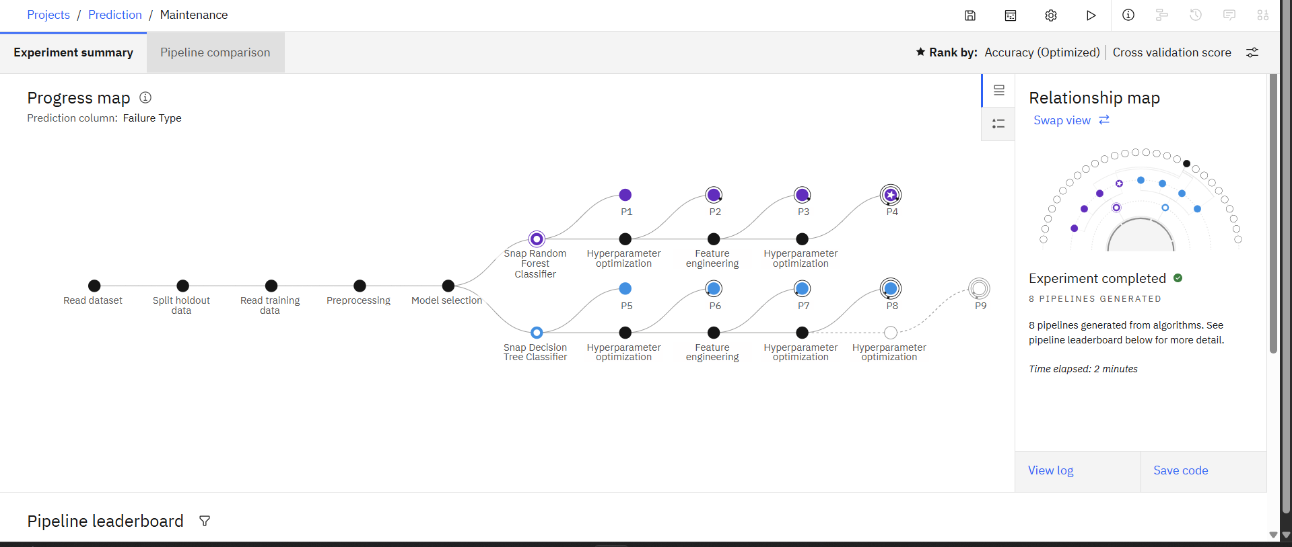
Result

Slide 8
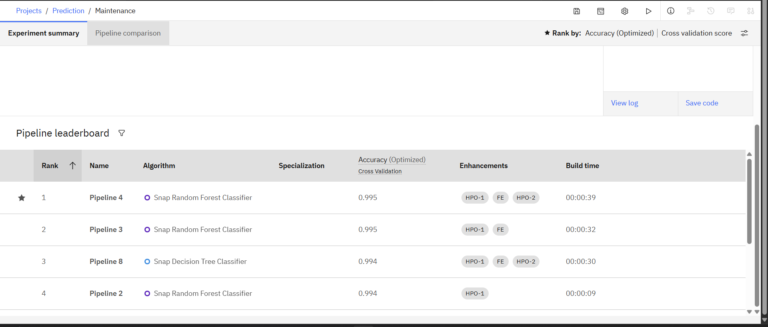
Result

Slide 9
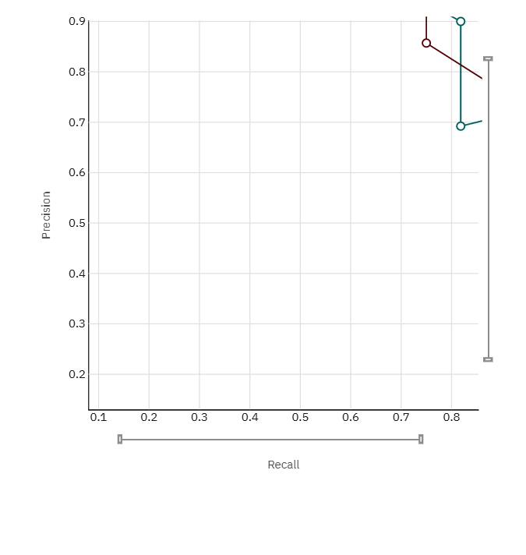
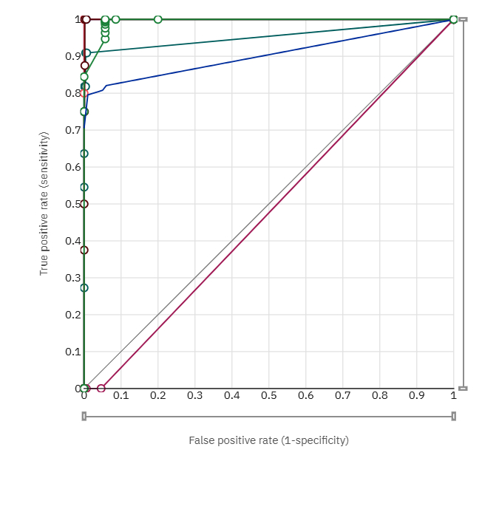
Result

Slide 10
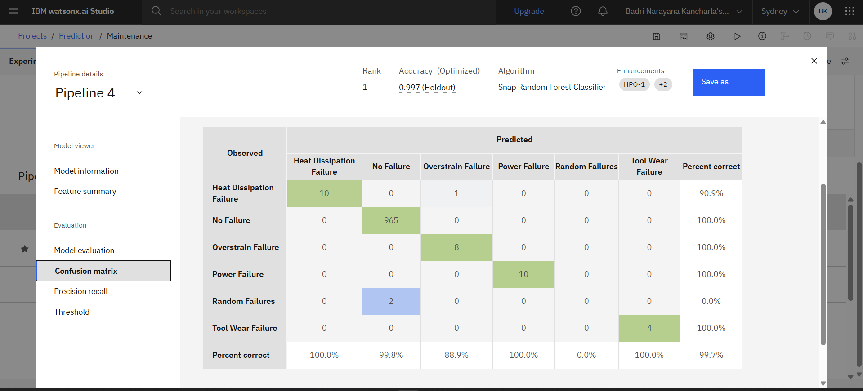
Result

Slide 11
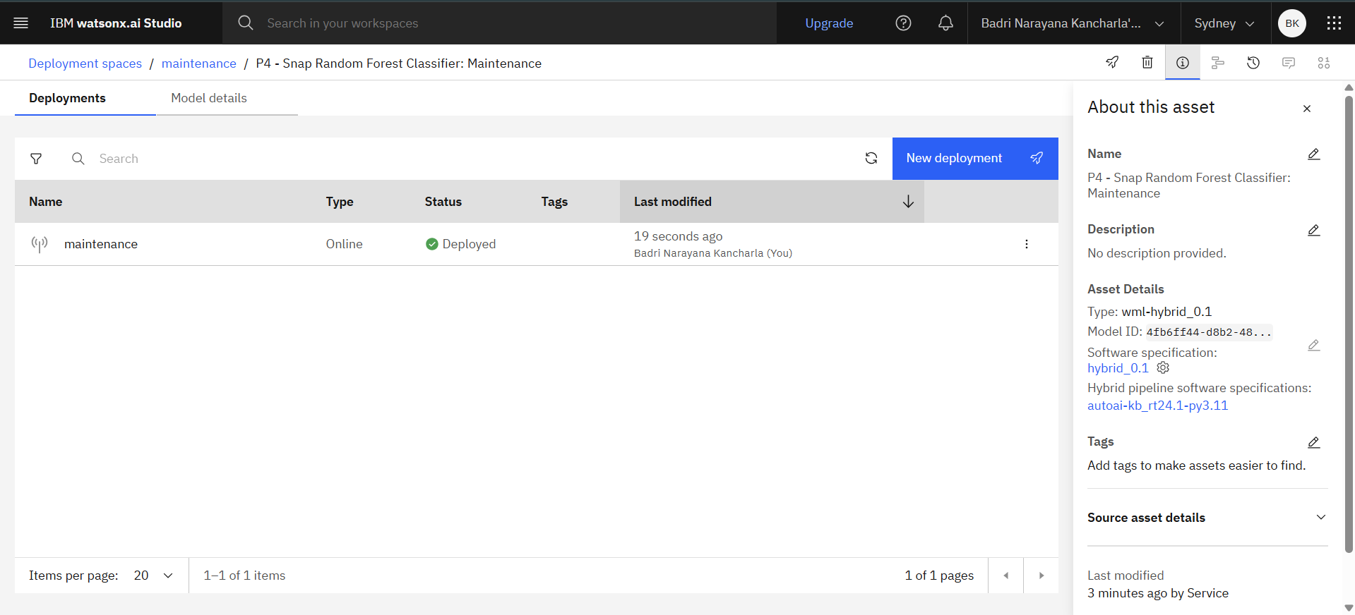
Result

Slide 12
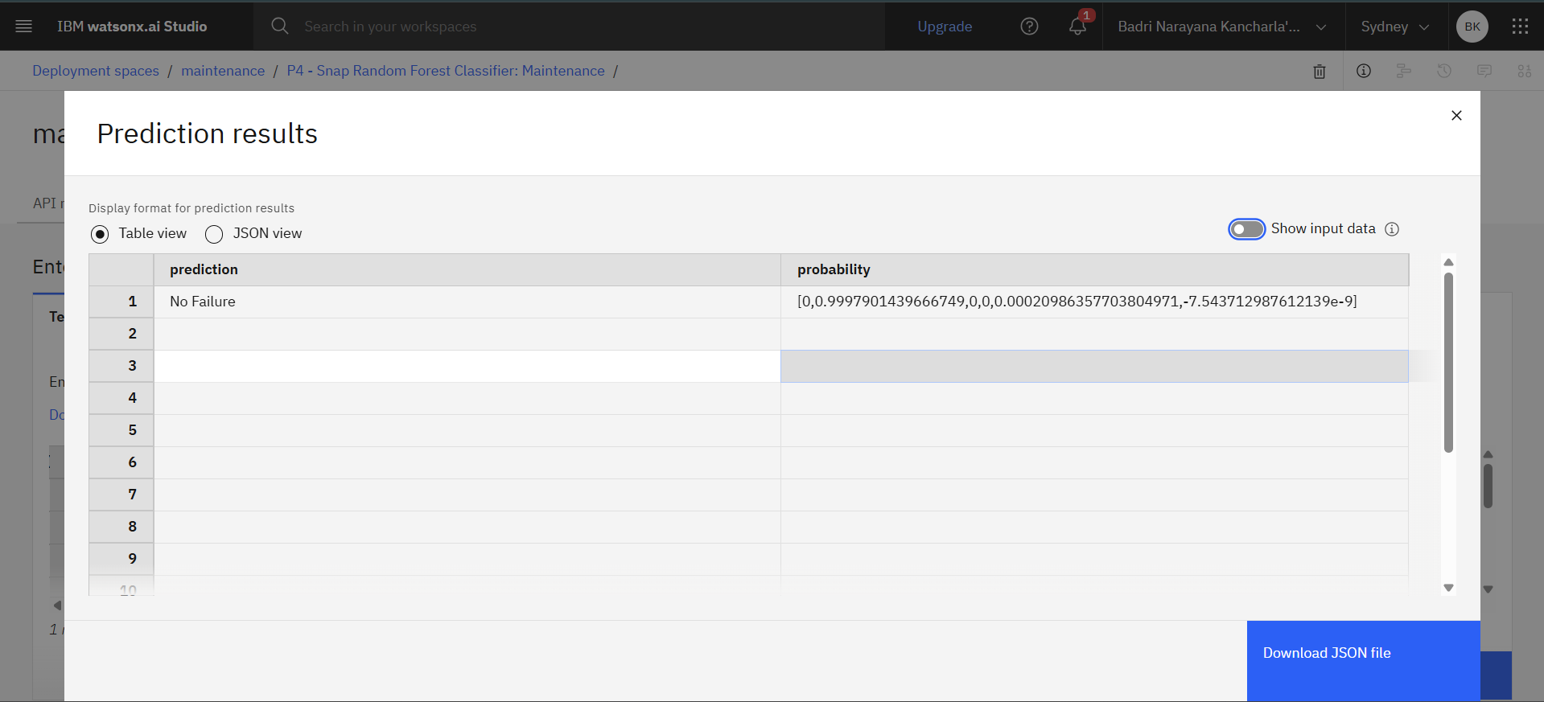
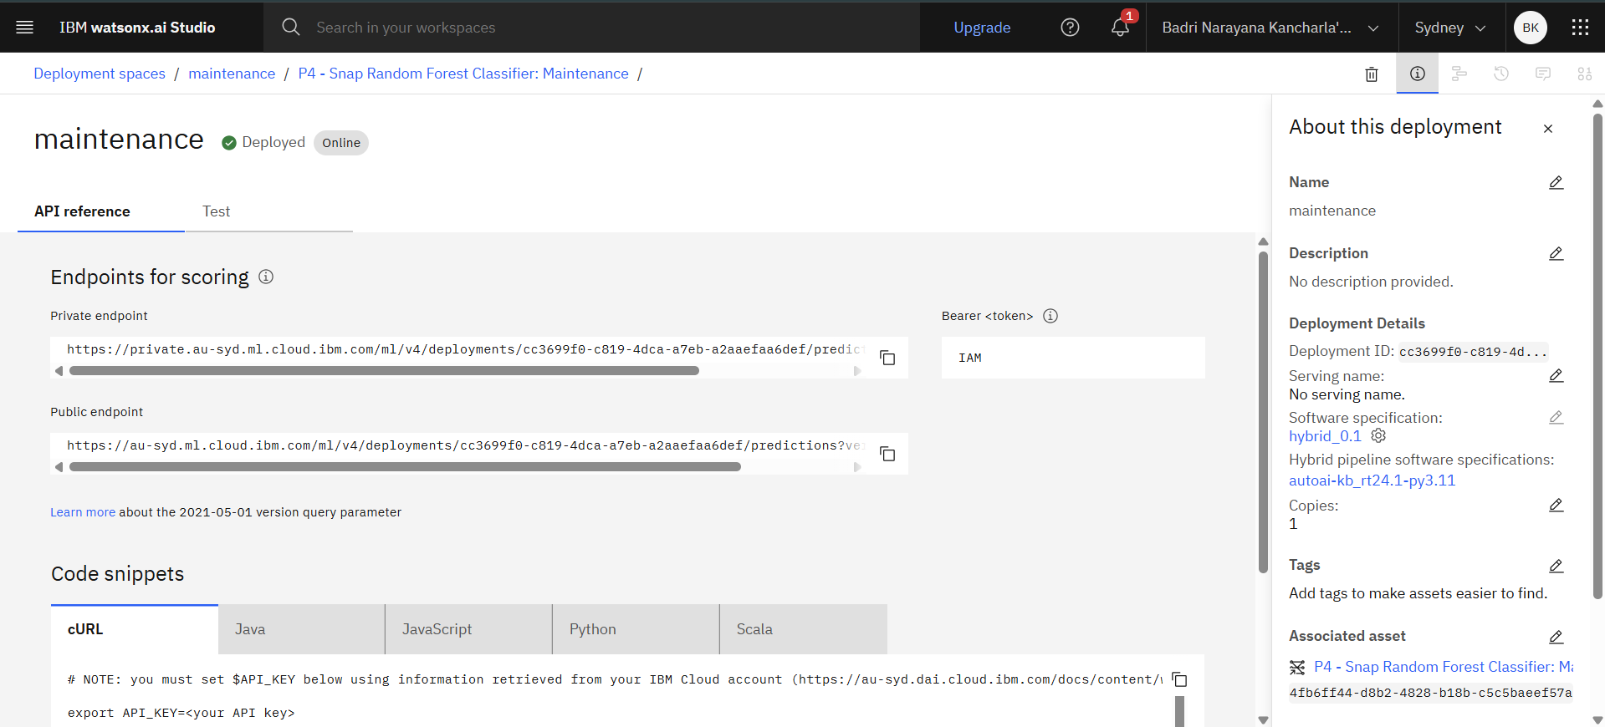
Result

Slide 13
Conclusion
Findings: AutoAI’s Snap Random Forest Classifier achieves 0.997 accuracy (holdout), with 99.7% overall percent correct across failure types.
Effectiveness: High precision (e.g., 100% for No Failure, Tool Wear Failure) and recall (e.g., 10/10 for Heat Dissipation Failure) ensure reliable failure predictions, reducing industrial downtime.
Challenges: Imbalanced data (e.g., Random Failures misclassified) and Lite tier compute limits impacted rare failure detection.
Improvements: Enhance model with more diverse data, optimize for edge cases.
Importance: Accurate failure predictions are critical for proactive maintenance, minimizing costs and enhancing machinery reliability.

Slide 14
Future scope
Future Scope
Add vibration, humidity data
Scale to multiple sites
Explore edge computing, deep learning

Slide 15
References
Kaggle: https://www.kaggle.com/datasets/shivamb/machine-predictive-maintenance-classification
IBM Watson Docs: https://cloud.ibm.com/docs/machine-learning
IEEE Paper (2020): Predictive Maintenance

Slide 16
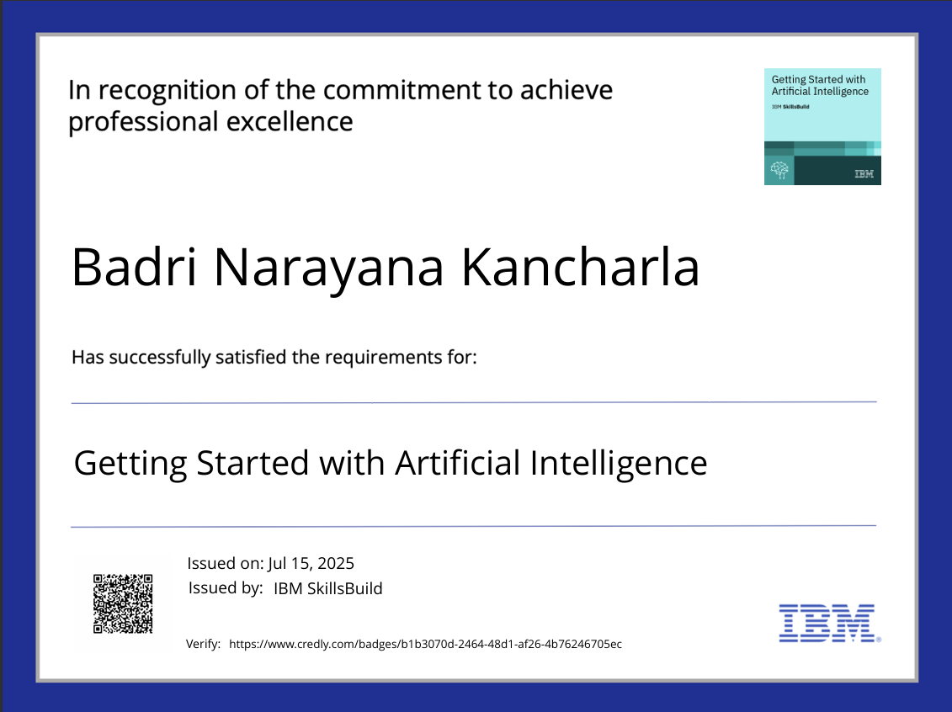
IBM Certifications

Slide 17
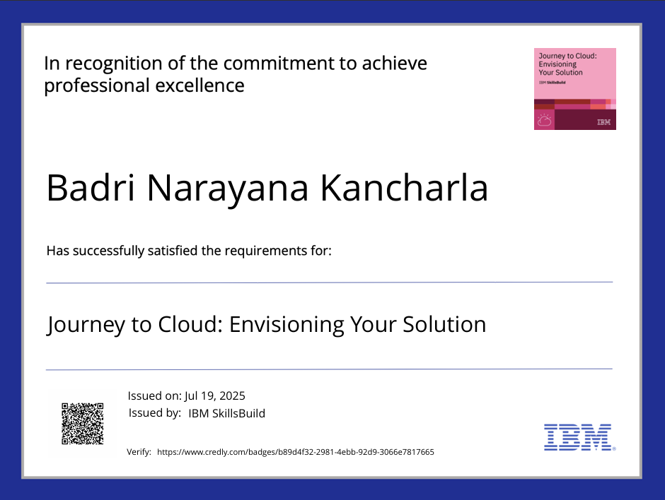
IBM Certifications

Slide 18
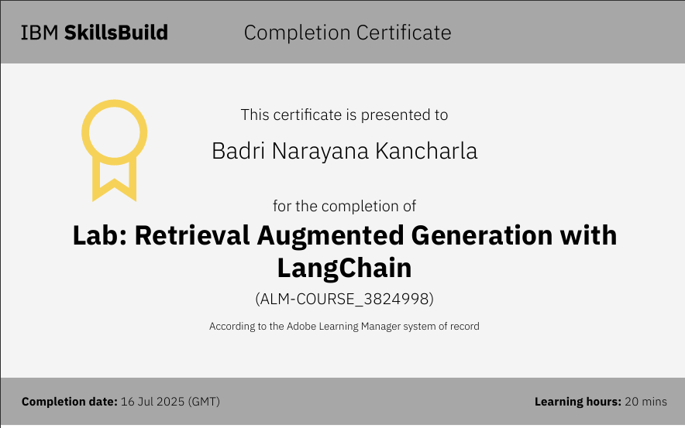
IBM Certifications

Slide 19
THANK YOU

